Slide 1
Choosing a Clean Vehicle
Presented by Ashley Miller
ashley@breatheutah.org

Slide 2
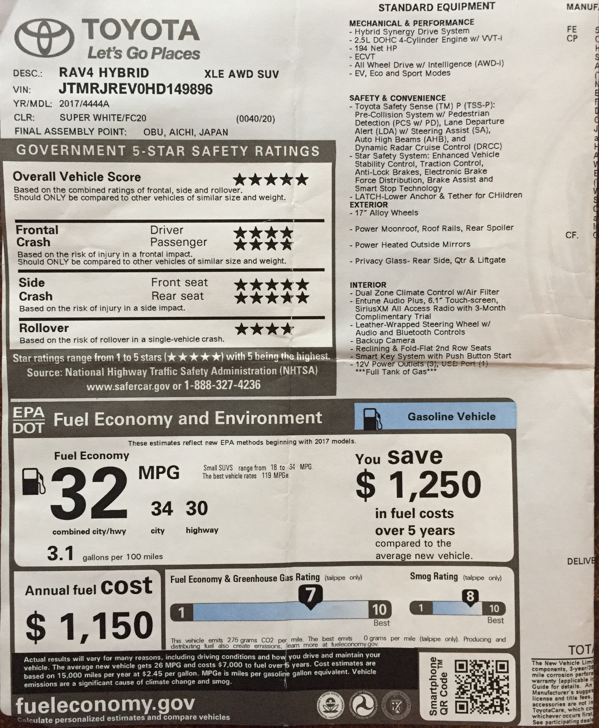
Window Sticker: The Monroney Label

Slide 3
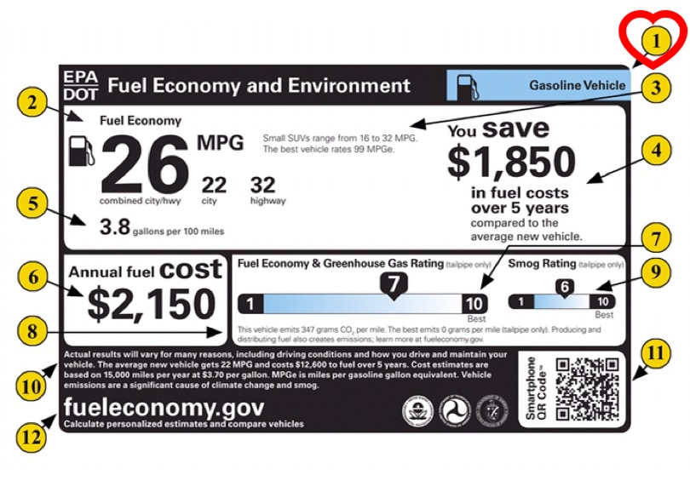
Fuel Type
Notes:
This area indicates how the vehicle is powered. This label is for a vehicle powered by gasoline. Labels are available for Diesel, Compressed Nat. Gas, Hydrogen Fuel Cell, Flexible-Fuel vehicle Gas-Ethanol (E85), Plug in Hybrids and Electric. Hybrid vehicles that do not have plug-in capability are identified as gasoline vehicles since they only use gasoline.

Slide 4
Fuel Economy: miles per gallon
The Combined MPG value is the most prominent for the purpose of quick and easy comparison across vehicles.
Some form of the MPG metric has been on vehicle labels since 1977.
Notes:
2. Fuel Economy. For gasoline vehicles, the label shows City, Highway and Combined MPG values (miles per gallon). The Combined MPG value is the most prominent for the purpose of quick and easy comparison across vehicles. Some form of the mpg metric has been on vehicle labels since 1977. Combined fuel economy is a weighted average of city and highway mpg values that is calculated by weighting the city value by 55% and why value by 45%.

Slide 7
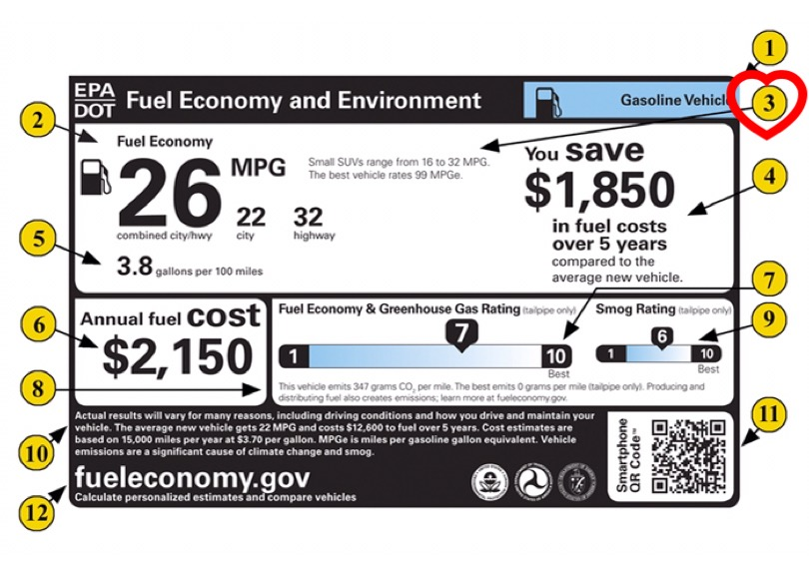
Comparing fuel economy to other vehicles
Notes:
This text indicates the category of the vehicle, example small SUV, station wagon, pickup truck, etc. and the best and worst fuel economy within that category for the given model year. There are 9 car categories, 6 truck categories, and a special purpose vehicle category. These categories are used only for labeling and consumer information purposes only and do not serve any other regulatory purpose. For each model year, EPA publishes lists identifying the best and worst fuel economy performers in each category available on fueleconomy.gov.

Slide 8
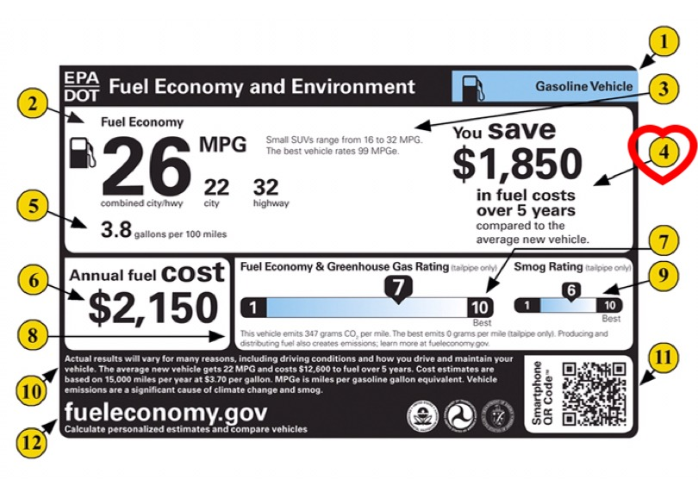
Money Saved!
Notes:
This shows the estimated fuel cost over a 5 year period for the vehicle compared to the average new vehicle. If the vehicle would save the consumer money compared to the average vehicle, the label would state “You save x in fuel costs over 5 years compared to the average new vehicle. If the vehicle costs more to operate than the average, the label states “You spend x more in fuel costs over 5 years compared to the average new vehicle. These estimates are based on driving 15,000 miles per year, for five years, and the projected fuel price for the year. In this particular label, the price per gallon was $3.70.

Slide 9
Fuel Consumption Rate
Notes:
A miles per gallon estimate is a required feature that has appeared on the fuel economy label for several decades. This metric can be misleading when consumers compare fuel economy improvements, especially when they use it in place of fuel costs. There is a non-linear relationship between gallons used over a given distance and miles per gallon. The revised label includes both the fuel economy and consumption information for all vehicle types.

Slide 10
Estimated Annual Fuel Cost
Annual mileage of 15,000 miles
Projected gasoline price
Notes:
The annual fuel cost is based on two assumptions: an annual mileage of 15,000 miles and a projected gasoline price.

Slide 11
Fuel Economy and GHG Rating
Notes:
The new label assigns each vehicle a rating from 1 (worst) to 10 (best) for fuel economy and greenhouse gas emissions (how much carbon dioxide the vehicle’s tailpipe emits each mile. A higher fuel economy is associated with a better GHG emissions profile. Two ratings apply to each vehicle, one for fuel economy and one for greenhouse gas emissions, but gasoline vehicles will only display ONE rating. This is because carbon dioxide emissions are directly related to the amount of fuel consumed. This varies from fuel to fuel, but both rating systems are based on gasoline vehicles, ultimately meaning that gasoline vehicles get the same rating for fuel economy and for greenhouse gas emissions.

Slide 12
CO2 Emissions Information
Combined City/Highway CO2 tailpipe emissions
Vehicle with lowest CO2 emissions
fueleconomy.gov
Notes:
This fine print text provides three key pieces of information.
Combined City and Highway CO2 tailpipe emissions. The vehicle’s tailpipe co2 emissions are based on tested tailpipe co2 emissions rates. The rate of co2 emissions is displayed in grams per mile.
Vehicle with lowest CO2 emissions. The label identifies the lowest co2 tailpipe emissions of available vehicles. If there are electric or fuel cell vehicles on the market, which by definition have zero tailpipe emissions, the value will be zero grams per mile.
Learn more about the emissions from the production of fuels at fueleconomy.gov. Driving your vehicle can yield both GHG emissions from your tailpipe and GHG emissions related to the production of the fuel used to power your vehicle. Ex. Activities associated with fuel production such as feedstock extraction, feedstock transport to a processing plant, and conversion of feedstock to motor fuel, as well as distribution of the motor fuel, can all produce GHG emissions. The rating on the label DOES NOT reflect any GHG emissions associated with FUEL PRODUCTION.
The fueleconomy.gov greenhouse gas calculator is a tool you can use to estimate the total GHG emissions that would be associated with driving an EV, or Plugin hybrid, including GHG emissions from the production of electricity used to power the vehicle.

Slide 13
Beyond Tailpipe Emissions fueleconomy.gov

Slide 14
The Fine Print
Notes:
This part of the label has a reminder that your fuel economy and emissions may be different due to several factors including how you drive, maintain, and use your vehicle. Weather, road conditions, load, etc. This also details the assumptions that are used to determine the estimated annual fuel cost and the value used to compare 5 year costs to the average vehicle. Again, that 15,000 miles per year assumption and the price of gas.

Slide 15
QR Code
Notes:
When looking for a new vehicle at a dealership you will be able to scan the QR code on the new label using your smartphone. Just download a scanner app. The QR Code will link you to helpful tools and additional info about the vehicle. The same tools are available on fueleconomy.gov

Slide 16
fueleconomy.gov
Notes:
This last part of the new label directs the consumer to fueleconomy.gov one last time. This website is a very helpful tool. You can compare vehicles, enter personalized information like your local gas prices and your own personal driving habits, to get the best possible cost and energy use estimates. The site is free and provides so much information leaving you an informed consumer when you go make that next vehicle purchase.

Slide 17
Smog Rating
Vehicle tailpipe emissions
Contributing to local and regional air pollution
Notes:
A SMOG rating is a rating for vehicle tailpipe emissions of those pollutants that cause smog and other local air pollution, like our fine particulate matter pollution we see so often in the wintertime. The ratings are based on a scale of 1-10, 1 being the worst, or most polluting, 10 being best, or least polluting. This scale is based on the U.S. vehicle Emissions Standards, which incorporate specific thresholds for Nitrogen oxide, non-methane organic gas, carbon monoxide, particulate matter, and formaldehyde. Electric vehicles, running on only electricity have a SMOG rating of 10 because the tailpipe emissions are ZERO.

Slide 18
Why do we care?
During the winter, roughly 48% of the emissions leading to our pm2.5 pollution along the Wasatch Front comes from mobile sources.
Vehicles account for roughly 45% of the emissions that lead to summertime ozone formation.
Vehicle miles traveled in Utah are expected to double by 2040.

Slide 19
What a smog rating means for our Air Quality
The average new vehicle sold has a smog rating of 5
Purchasing a vehicle with a smog rating of 8 results in 1/5 the emissions of a vehicle with a 5
More 8 and above ratings on Utah’s roads means fewer vehicle emissions entering our air shed

Slide 20
HCR 18: Encouraging Utahns to consider the smog rating when purchasing vehicles
Notes:
During the 2017 Legislative Session, Rep. Patrice Arent along with Floor Sponsor Senator Brian Shiozawa ran a concurrent resolution encouraging Utahns to consider a vehicle’s smog rating when purchasing their next vehicle. The resolution garnered the support of 46 members of the Utah House of Representatives, all joining the resolution as co-sponsors. The resolution itself brings attention to the health effects of air pollution, the impacts of vehicle emissions on our air shed, and the positive impact choosing a cleaner vehicle, with a smog rating of 8 or higher, has on improving the air we breathe. The resolution passed both the House and Senate. Here we see the Governor signing HCR 18.

Slide 21
Vehicle Emission Control Information: Under the hood
Notes:
Another place to find emissions information is under the hood. This is a way to find the information if you are purchasing a used vehicle from a private party, where there wouldn’t be a window sticker affixed. The US EPA rating T3 B30 means this is a Tier 3 Bin 30 vehicle.

Slide 22
Good News!
There are many vehicles on Utah lots right now that have a smog rating of 8 or higher.
Hybrids, Plug-in Hybrids and Full Electric models are available for purchase in our state.

Slide 23
Cleanest Vehicle: Zero Tailpipe Emissions

Slide 24
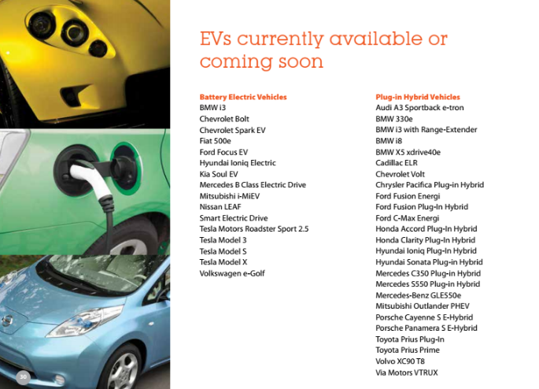
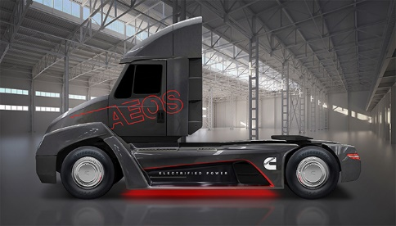
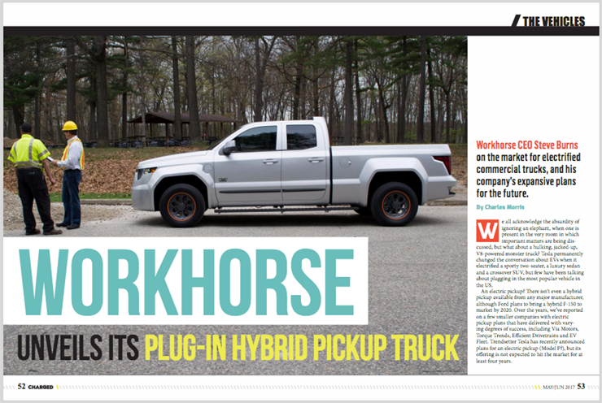

Slide 25
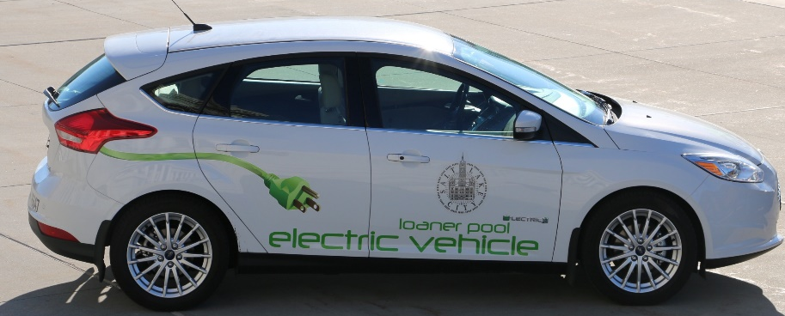
Adding Clean Vehicles to Fleets: Begin with your team at work.
Human Resources
Fleet Manager
Building Operations
Maintenance
Sustainability
Survey of employees to meet current and expected needs
Utah Clean Cities

Slide 26
Why Businesses Choose EVs
Cheaper to fuel
Less volatile fuel prices
Less maintenance
Driving performance
Fewer to Zero emissions
Purchase price declining
Notes:
See document.

Slide 27
Promoting Clean Vehicles at the Workplace
Work with fleet manager to deploy clean vehicles in fleet
Work with travel coordinator to encourage clean vehicle rental for employee travel
Invite clean EV driving employees to share their stories and encourage other employees
Provide EV charging for employees
Provide optimally located reserved parking places for EV drivers when not charging

Slide 28
Incentives for Purchasing EVs
Federal Tax Incentive $7,500
Rocky Mountain Power Customer Incentives for 2017 Nissan Leaf
EV pilot project up to $5,000 incremental costs of EV fleet vehicle over the cost of a comparable gas/diesel model

Slide 29
Workplace Charging Incentives: Rocky Mountain Power and Live Electric
Non-Residential AC Level 2 Charger: Up to $3,000 per charger up to 75% of total charger cost
DC Fast Charger: Up to $30,000 per charger up to 75% of total charger and installation costs
Grant based custom projects and partnerships
Notes:
Utah Clean Cities can help you with the application process.

Slide 30
Notes:
You can have charging assessed as monthly fees, free to employees and visitors, charged to visitors and employees or a combination of all. You can plug in fleet vehicles at night for a slow charge, or add DC Fast Charging at a great rate.

Slide 31
Q&A

Slide 32
Thanks for listening!
For more information or help with your fleet needs, contact Utah Clean Cities.
utahcleancities.org
tammie.cooper@utahcleancities.org

